Slide 1
Design, Development and Construction of a Magnetohydrodynamic Cocktail Stirrer
Carlos Gross Jones

Slide 2
Problem
Density- and temperature-driven separation in cocktails

Slide 3
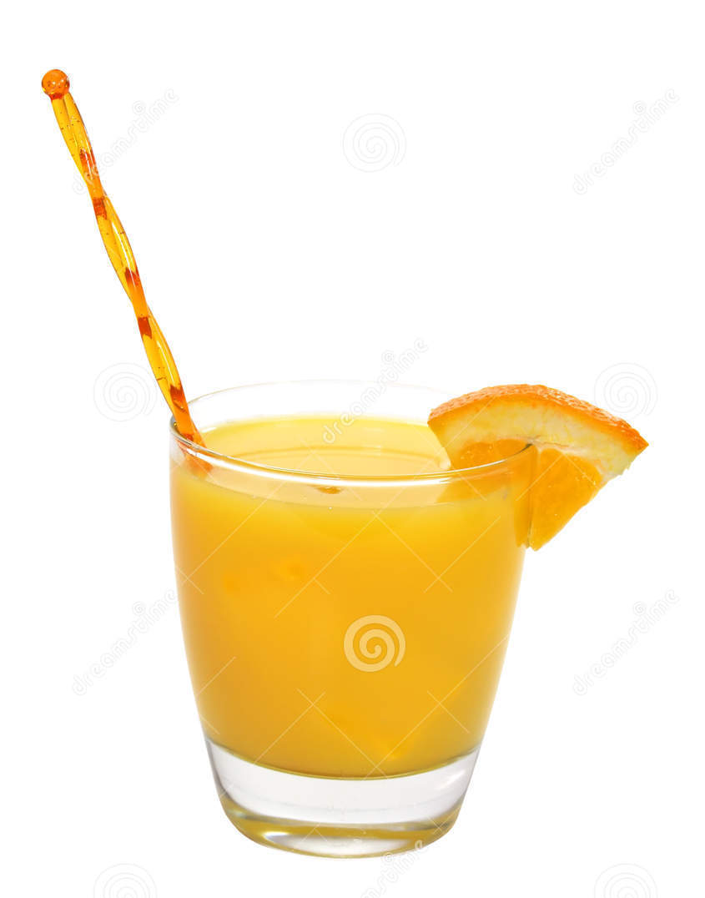
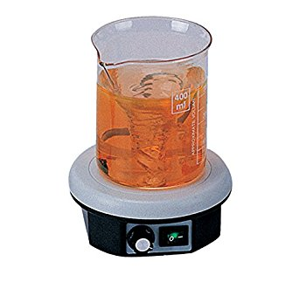
Existing Solutions
Spoon, Swizzle Stick
Lab Stir Plate
Boring
Uses magnetic “pill”
Possibility of cross-contamination
Pill must be retrieved
Still pretty boring

Slide 4
Proposal: Contactless Cocktail Stirrer
Truly contactless (no magnetic “pill”)
Uses magnetohydrodynamics
Electrical and magnetic interactions with conductive fluid

Slide 5
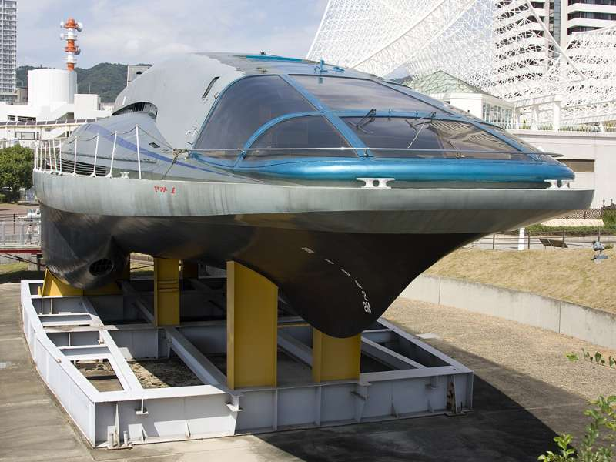
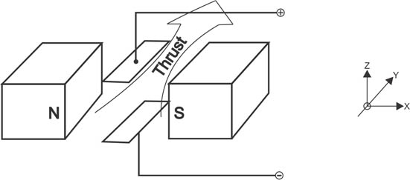
Magnetohydrodynamics
Well studied in marine propulsion
Simplest applications is Lorentz-force drive

Slide 6
Early Efforts: 2013
Used direct insertion of current (electrodes in drink)
NdFeB permanent magnet
Advantages:
Simple
Provides good pumping
Disadvantages:
Electrolysis of drink
Electrically-driven erosion of electrodes

Slide 7
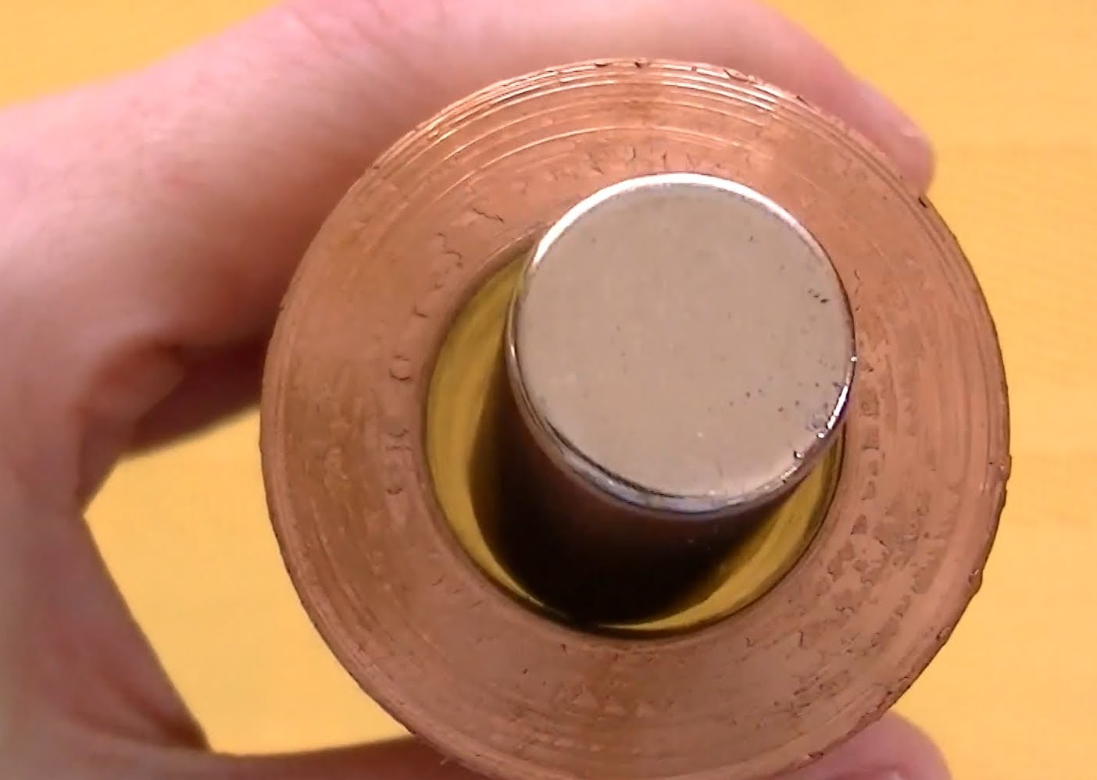
Current effort: Magnetodynamic Coupling
Changing magnetic field induces currents (Faraday’s Law)
Eddy currents interact with original magnetic field (Lorentz force)
Commonly used in contactless braking systems

Slide 8
Challenges
Root problem: cocktails are much less conductive than copper
Requires large dB/dt to create significant force
Increase field strength, rate of change, or both
Must meet budget and space constraints
No superconductors, custom magnets, etc.
Must fit in my living room

Slide 9
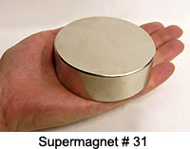
Magnet Selection
Supermagnet from United Nuclear
3” dia., 1” thick
NdFeB 45

Slide 10
Magnetostatic Analysis: FEMM
Used to characterize static field
Quadrupole arrangement provides stronger (maximum) field than dipole
1018 steel shunts to provide good return path
Maximum of 0.418 T in glass

Slide 11
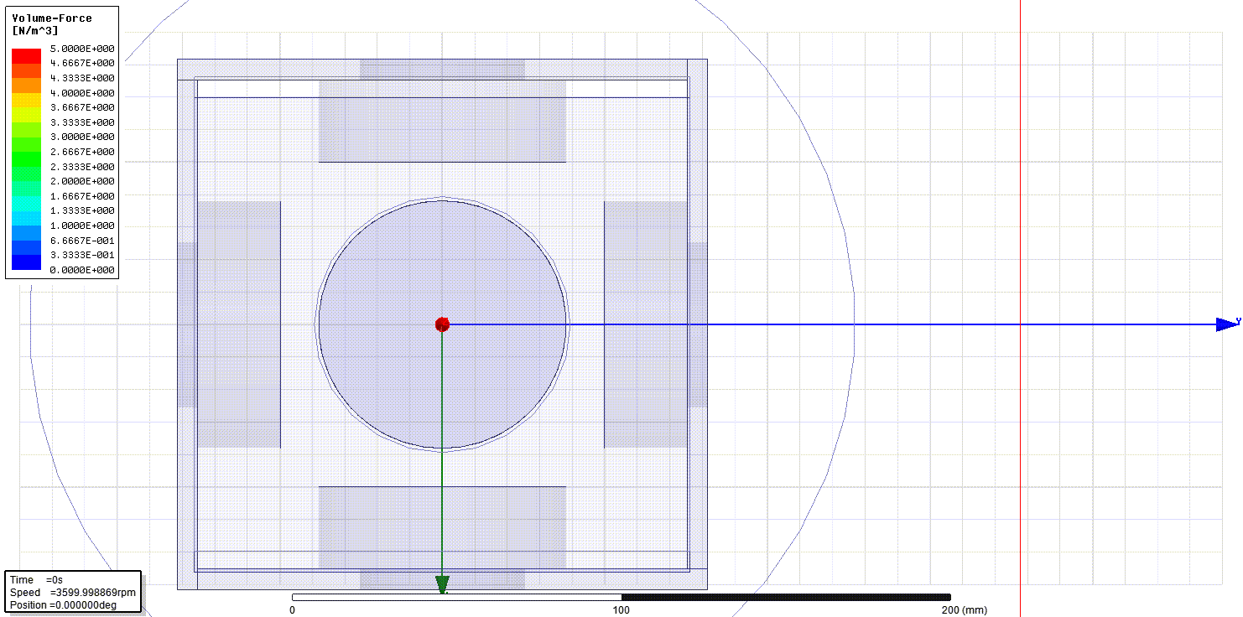
Magnetodynamic Analysis: Ansys Maxwell
Quadrupole assembly spun at 3600 RPM
Seawater used as conductivity baseline
Generates force vector field result
Maximum of 3.3 N/m³

Slide 12
Computational Fluid Dynamics: OpenFOAM

Slide 13
Conductivity Characterization
Experimental apparatus:
½” x ½” x 24” UHMW trough
Capacitively-coupled plates at ends
50 kHz sinusoidal excitation
Stages:
Measure conductivity of precursors (liquor, mixers, etc.)
Measure conductivity of common cocktails
Optimize for conductivity

Slide 14
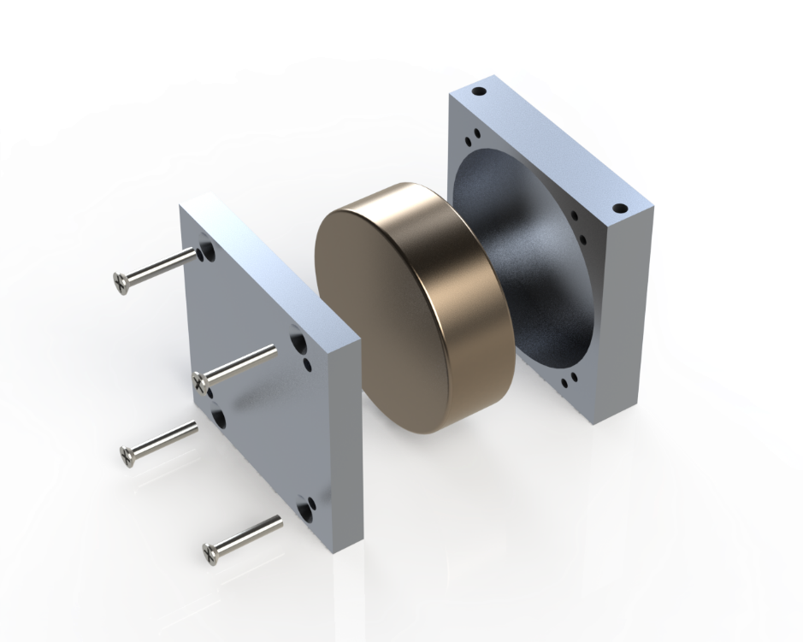
Mechanical Design: Magnet Holders
Magnets contained in aluminum housings for mounting & protection
316 stainless steel (nonmagnetic) screws used

Slide 15
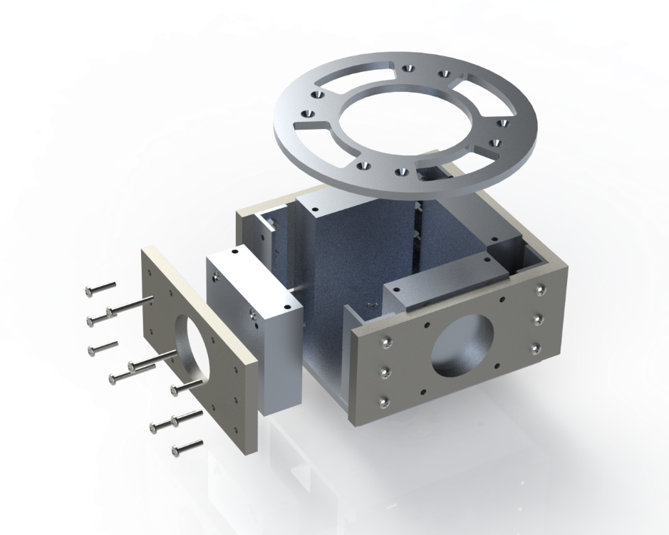
Mechanical Design: Spinner Assembly
Assembly of four magnets into “spinner”
Steel shunts form part of spinner structure
Assembly anticipated to be challenging

Slide 16
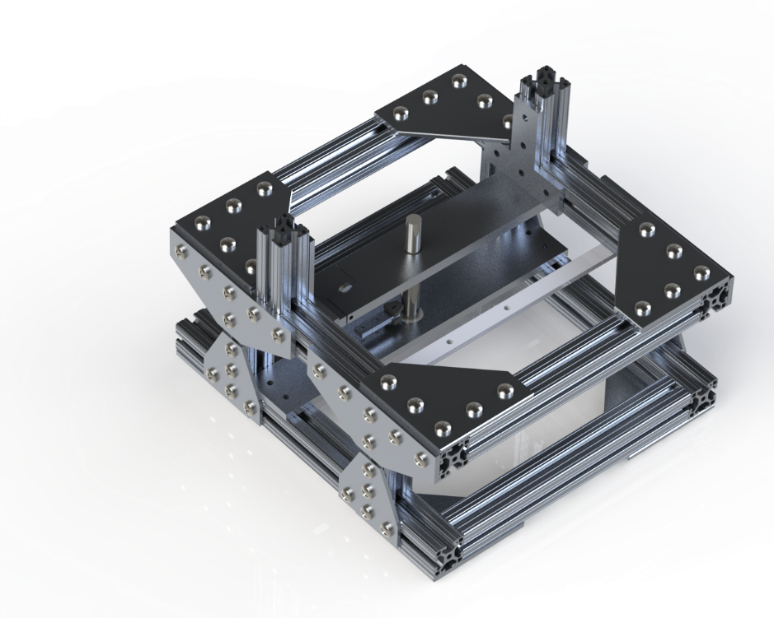
Mechanical Design: Frame
Speed (3600 RPM) and weight (~20 lb) of spinner assembly necessitate very robust structure
1.5” 80/20 extrusion frame

Slide 17
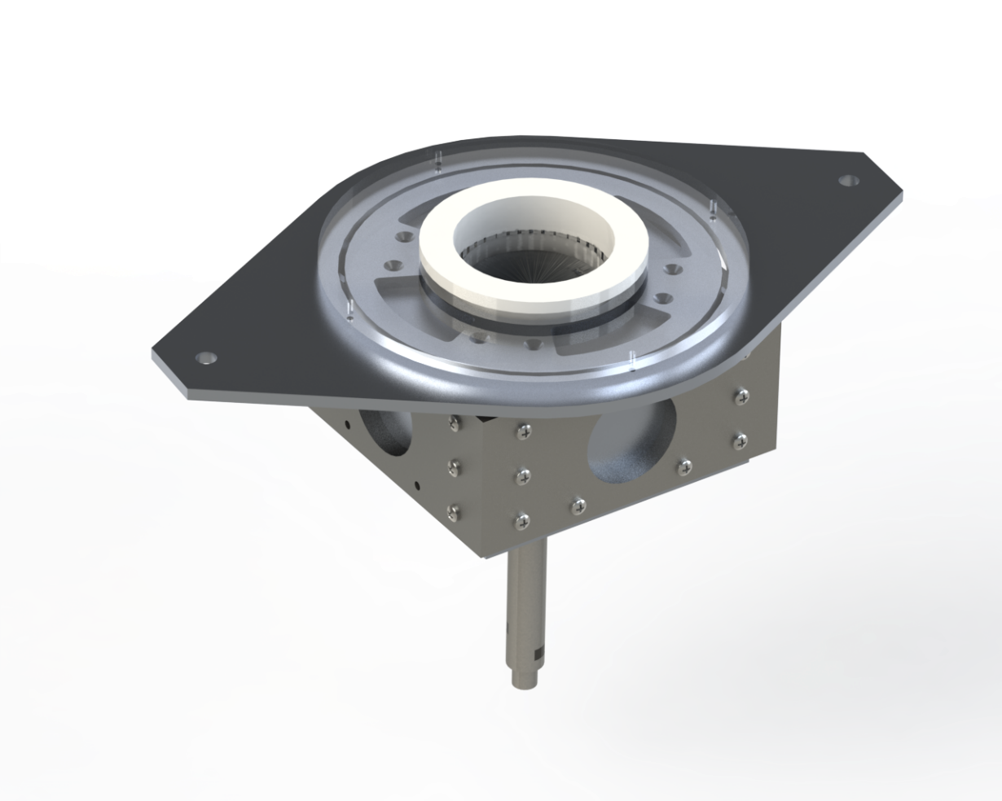
Mechanical Design: Glass Support
Cocktail glass must be suspended in spinner assembly
Materials must be nonmagnetic and nonconductive
Delrin cup in Lexan ring

Slide 18
Mechanical Design: Balancing
Spinner must be carefully balanced
Load cell on crossbar monitors centrifugal force
By correlating with shaft encoder, angular location of mass overburden can be found
Balance mass added on opposite side to balance spinner

Slide 19
Mechanical Design: Power
12 VDC CIM motor drives spinner
Coupled to spinner shaft by #25 roller chain

Slide 20
Control System
MDL-BDC24 PWM motor controller (40 A continuous)
Internal PID loop for velocity control
Controlled via CAN
National Instruments cRIO-9022 controller
Realtime OS
FPGA backplane
12 VDC, 50 A power supply

Slide 21
Control System
cRIO monitors:
Centrifugal force sensor
Shaft encoder
Motor voltage & current (via MDL-BDC24)
User interface
And controls:
MDL-BDC24
Main power contactor

Slide 22
Safety
cRIO shuts down motor if monitored parameters exceed safe limits
MDL-BDC24 can “brake” motor (short across armature)
“Emergency bushing” designed to limit maximum wobble of spinner
User behind barrier, at least for initial tests

